Slide 1
Information Visualization Project Proposal and Dataset
G3-A
75180 – Adriana Domingos
75541 – Tomás Alves
75551 – Miguel Santos

Slide 2
DOMAIN
01

Slide 3
Domain
High level description
Data related to the Second World War.
World War II was one of the definitive events of the 20th century, if not all of human history.
European theatre

Slide 4
DATASET
02

Slide 5
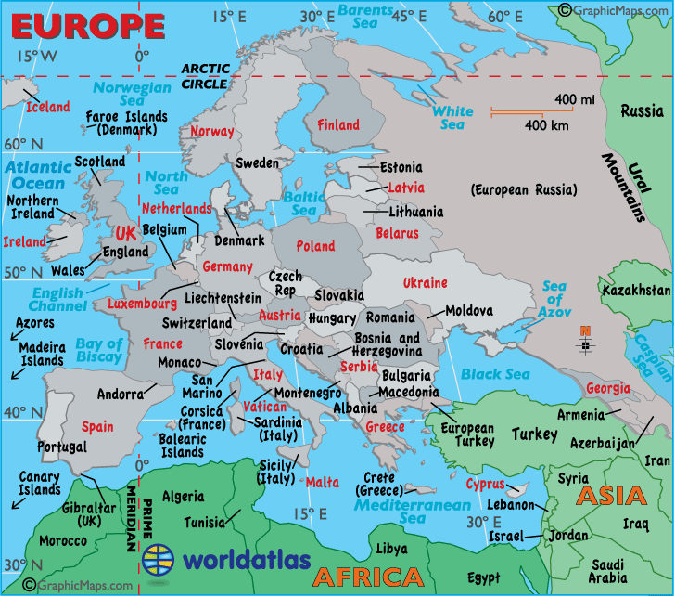
Dataset
Dataset description
Static tables from Wikipedia.

Slide 6
TASKS
03

Slide 7
Tasks
Task 1
High-level: Analyze -> Consume -> Present
Analyze the casualties during the WW2
Task 2
Mid-level: Search -> Browse
Search for the greatest battles in the war
Task 3
Low-level: Query -> Identify
Identify which commander led each battle

Slide 8
Example QUESTIONS
04

Slide 9
Questions
Who was the worst commander?
Which was the biggest battle?
Where were the frontlines?
How did the casualties varied throughout the war?
Which side lost more men?

Slide 10
Data Sample
05

Slide 11
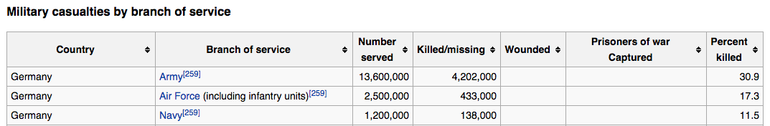
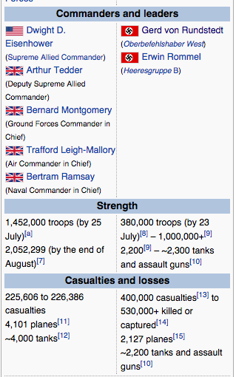
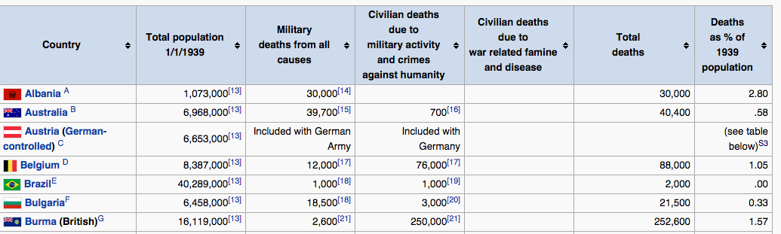
Data Sample

